Slide 1
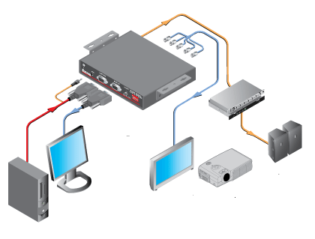
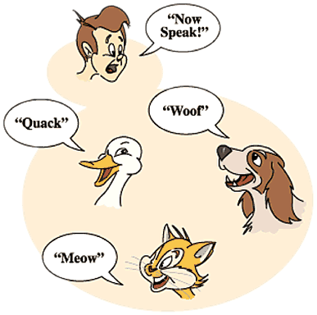
Abstraction and Polymorphism
SoftUni Team
Technical Trainers
Software University
https://softuni.bg

Slide 2
Have a Question?
sli.do
#prgm-for-qa

Slide 3
Table of Contents
Abstraction
Interfaces
Abstract Classes
Interfaces vs Abstract Classes
Polymorphism
The is Keyword
The as Keyword

Slide 4

Achieving Abstraction
Abstraction

Slide 5
What is Abstraction?
From the Latin
Preserving information, relevant in a given context, and forgetting information that is irrelevant in that context
Abs
(away from)
Trahere
(to draw)
Abstraction
5

Slide 6

Abstraction in OOP
Abstraction means ignoring irrelevant features, properties, or functions and emphasizing the ones …
... relevant to the context of the project we develop
Abstraction helps managing complexity
Abstraction lets you focus on what the object does instead of how it does it
"Relevant" to what?
6

Slide 7
How Do We Achieve Abstraction?
There are two ways to achieve abstraction
Interfaces
Abstract class
public interface IAnimal {}
public abstract class Mammal {}
public class Person : Mammal, IAnimal {}
Notes:
There are two ways to achieve abstraction
- Using Abstract Classes
- Using Interfaces

Slide 8
Abstraction vs Encapsulation
Abstraction
Process of hiding the implementation details and showing only functionality to the user
Achieved with interfaces and abstract classes
Encapsulation
Used to hide the code and data inside a single unit to protect the data from the outside world
Achieved with access modifiers (private, protected, public … )
8

Slide 9

Working with Interfaces
Interfaces

Slide 10
Interface
Internal addition by compiler
public interface IPrintable {
void Print();
}
Keyword
Name (starts with I per convention)
compiler
public interface IPrintable {
public abstract void Print();
}
10

Slide 11
Interface Example
The implementation of Print() is provided in class Document
public interface IPrintable {
void Print();
}
class Document : IPrintable {
public void Print()
{ Console.WriteLine("Hello"); }
11
Notes:
There are two ways to achieve abstraction
- Using Abstract Classes
- Using Interfaces

Slide 12

Abstract Classes and Methods
Abstract Classes

Slide 13
Abstract Class
Cannot be instantiated
May contain abstract methods and accessors
Must provide implementation for all inherited interface members
Implementing an interface might map the interface methods onto abstract methods
13
Notes:
There are two ways to achieve abstraction
- Using Abstract Classes
- Using Interfaces

Slide 14
Abstract Methods
An abstract method is implicitly a virtual method
Abstract method declarations are only permitted in abstract classes
An abstract method declaration provides no actual implementation:
public abstract void Build();
14

Slide 15

Interfaces vs Abstract Classes

Slide 16
Interface vs Abstract Class (1)
Interface
A class may implement several interfaces
Cannot have access modifiers, everything is assumed as public
Cannot provide any code, just the signature
Abstract Class (AC)
May inherit only one abstract class
Can provide implementation and/or just the signature that have to be overridden
Can contain access modifiers for the fields, functions, properties
16

Slide 17
Interface vs Abstract Class (2)
Interface
Fields and constants can't be defined
If we add a new method we have to track down all the implementations of the interface and define implementation for the new method
Abstract Class
Fields and constants can be defined
If we add a new method we have the option of providing default implementation and therefore all the existing code might work properly
17

Slide 18


Polymorphism
ANIMAL

Slide 19
What is Polimorphism?
From the Greek
This is something similar to a word having several different meanings depending on the context
Polys
(many)
Morphe
(shape/forms)
Polymorphos
19
Notes:
Polymorphism is the ability of an object to take on many forms. The most common use of polymorphism in OOP occurs when a parent class reference is used to refer to a child class object.

Slide 20
Polymorphism in OOP
Ability of an object to take on many forms
public interface IAnimal {}
public abstract class Mammal {}
public class Person : Mammal, IAnimal {}
Person IS-A Person
Person IS-AN Animal
Person IS-AN Object
Person IS-A Mammal
20

Slide 21
Variable Type and Data Type
Variables Type is the compile-time type of the variable
Data Type is the actual runtime type of the variable
If you need an object method you need to cast it or override it
public class Person : Mammal, IAnimal {}
object objPerson = new Person();
IAnimal person = new Person();
Mammal mammal = new Person();
Person person = new Person();
Variable Type
Data Type

Slide 22
Keyword – is
Runtime check if an object is an instance of а specific class
public class Person : Mammal, IAnimal {}
IAnimal person = new Person();
Mammal personOne = new Person();
Person personTwo = new Person();
if (person is Person)
{
((Person)person).getSalary();
}
Check object type of person
Cast to object type and use its methods

Slide 23
is Type Pattern
Type pattern - tests whether an expression can be converted to a specified type and casts it to a variable of that type
public class Person : Mammal, IAnimal {}
Mammal personOne = new Person();
Person personTwo = new Person();
if (personOne is Person person)
{
person.GetSalary();
}
Checks if object is of type person and casts it
Uses its methods

Slide 24
is Constant Pattern
When performing pattern matching with the constant pattern, is tests whether an expression equals a specified constant
Checking for null can be performed using the constant pattern
int i = 0;
int min = 0, max = 10;
while(true)
{
Console.WriteLine($"i is {i}");
i++;
if(i is max or min) break;
}

Slide 25
Keyword – as
You can use the as operator to perform certain types of conversions between compatible reference types
public class Person : Mammal, IAnimal {}
IAnimal person = new Person();
Mammal personOne = new Person();
Person personTwo;
personTwo = personOne as Person;
if (personTwo != null)
{
// Do something specific for Person
}
Convert Mammal to Person
Check if conversion is successful

Slide 26

Summary
…
…
…
Abstraction
How do we achieve abstraction?
Interfaces
Abstract classes
Polymorphism - Definition and Types
is Keyword
as Keyword

Slide 27









Questions?

Slide 28













SoftUni Diamond Partners

Slide 29
Trainings @ Software University (SoftUni)
Software University – High-Quality Education, Profession and Job for Software Developers
softuni.bg, about.softuni.bg
Software University Foundation
softuni.foundation
Software University @ Facebook
facebook.com/SoftwareUniversity
Software University Forums
forum.softuni.bg
29
Notes:
29

Slide 30

License
This course (slides, examples, demos, exercises, homework, documents, videos and other assets) is copyrighted content
Unauthorized copy, reproduction or use is illegal
© SoftUni – https://about.softuni.bg
© Software University – https://softuni.bg
Notes:
30

